Slide 1
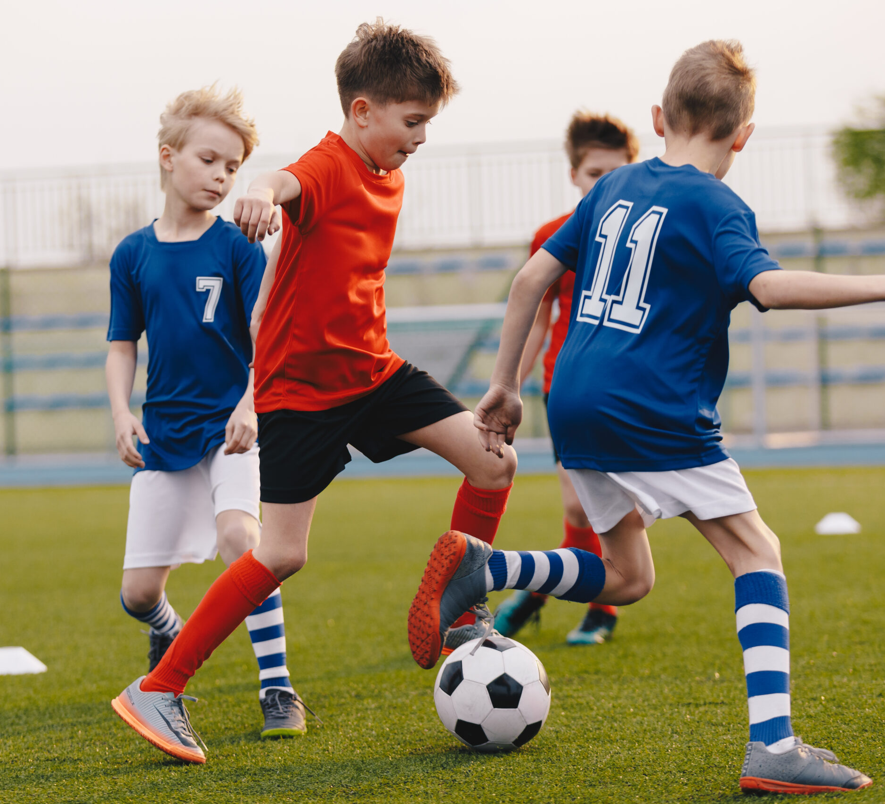
Building a Stronger Future: Enhancing Youth Sports Experiences
Sport Dojo
Summer 2023

Slide 2
Meet the team

Slide 3


About Us
At Sport Dojo, our mission is to enhance youth sports by making them more enjoyable, inclusive, and engaging for everyone ! We are dedicated to equipping the next generation of coaches with advance, data driven technology, and connecting them with meaningful contexts to make a difference.

Slide 4
Current Challenges and Barriers

Slide 5
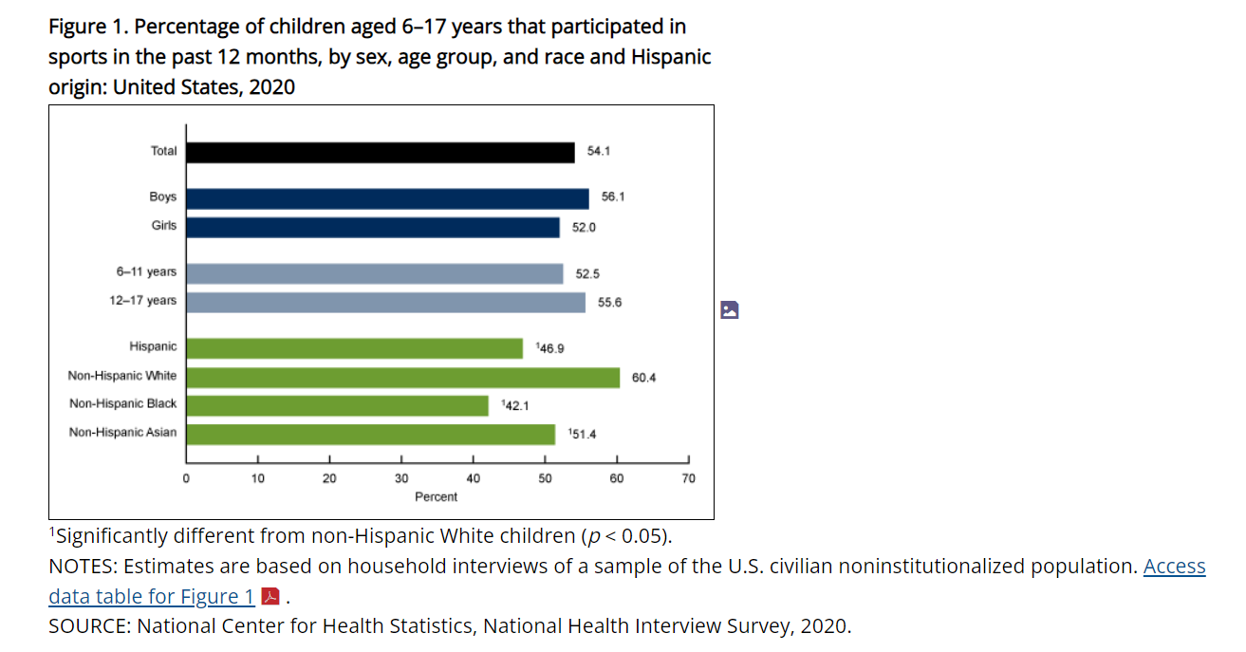

Disparities in Sports
According to the National Center for Health Statistics, there is a disparity in Racial and Ethnic where minors are being less considered in sports because of a lack of sufficient income or resources to participate.

Slide 6

The obstacles that remain ahead of us
Lack of inclusivity
Limited Coaching resources
Exclusivity and “Pay to Play” Structures
Decline in Skill Development
Digital Divide
Youth Coaching absences and Quality
Lack of Fun and Engagement
Fragmented Coaching solutions

Slide 7
SPORT DOJO’S Present and Upcoming Endeavors

Slide 8
Sport Dojo Initiatives:
Making youth Sports More Fun, Engaging, and Inclusive
01
Providing Quality coaching for every kid
02
Utilizing Technology to Enhance Coaching
03
Creating opportunities In local communities
04
Empowering the Next Generation of Coaches
05
Connecting Coaches with impactful Contexts
06

Slide 9
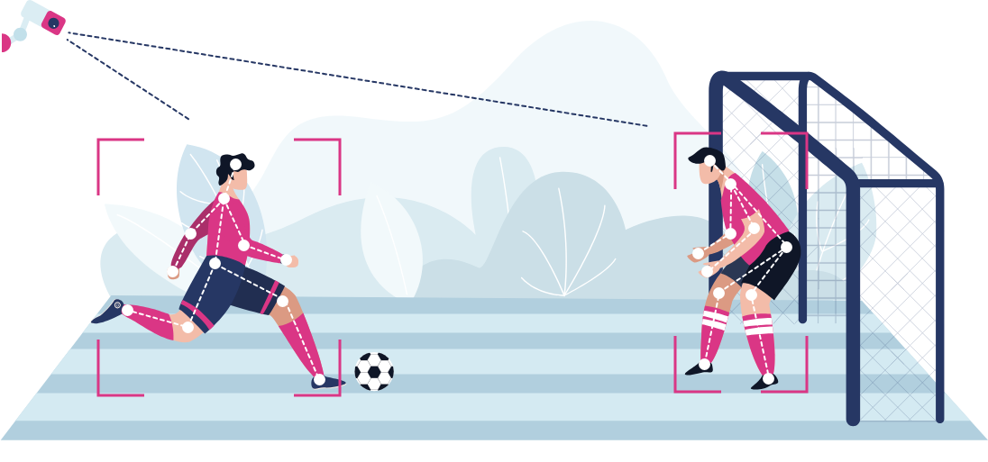
sport Dojo’s Technological contribution
Your Ultimate 21st Century Coaching Companion !
Analytically and visually captures every pitch moment.
Simplifies tracking your child's activities.
Enhances your understanding of the sport, fostering deeper connections.
Benefits parents, athletic directors, physical education teachers, video gamers, and sports fans.
A collective effort to reshape youth sports.
LARGE-SCALE | DATA-POWERED
Harnesses the potential of data science for youth sports.
Utilizes Google Cloud's secure system and cutting-edge AI technologies.
Developed by Dojo Science for unparalleled accuracy.
Ideal for large-scale camps, recreational programs, and school athletic departments.

Slide 10
Short and Long term benefits

Slide 11
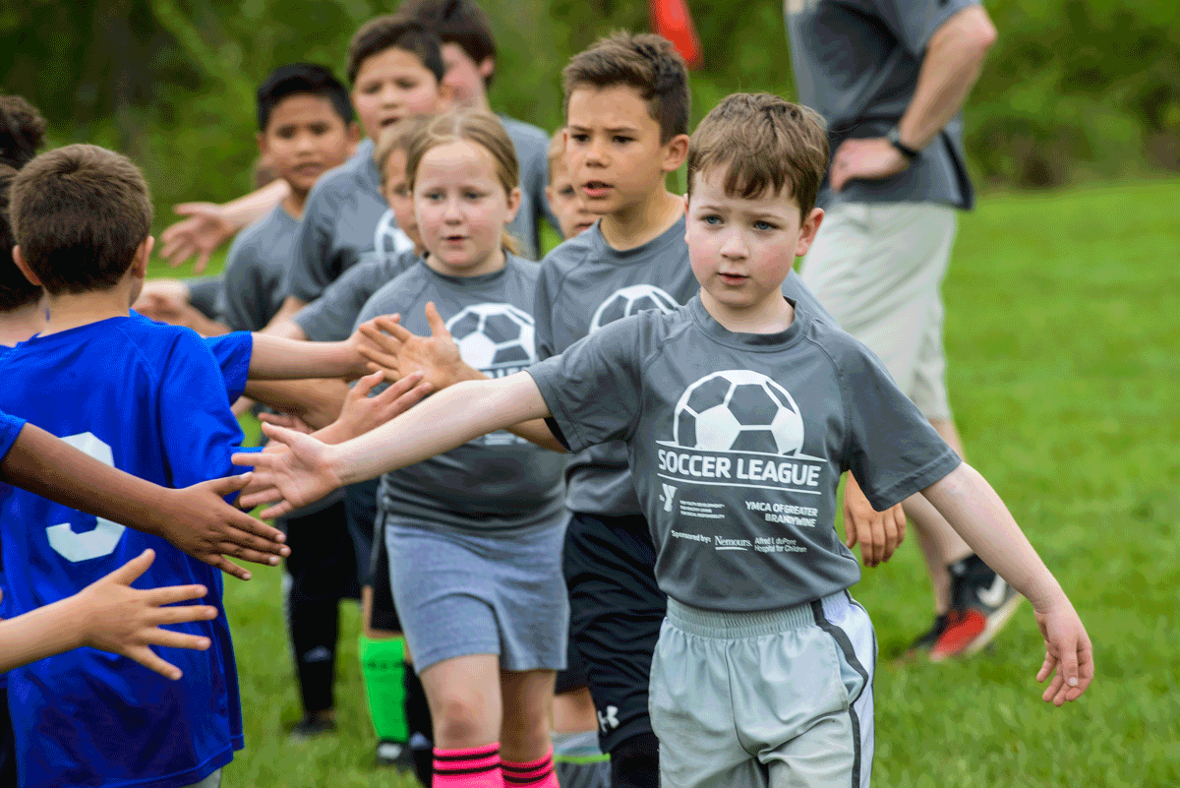
children Grow their Athletic Abilities
Skill Development: The focus on High quality coaching and resources can lead to better skill development for young athletes. This can help them improve their performance in their chosen sport
Confidence Building: With access to effective coaching and positive experiences, kids can build confidence in their athletic abilities which can extend to other areas of their lives.
Health and Fitness: With a positive environment and fun engaging activities, kids will be encouraged to actively participate in their sports that can contribute to better physical health and an active lifestyle in the future.

Slide 12
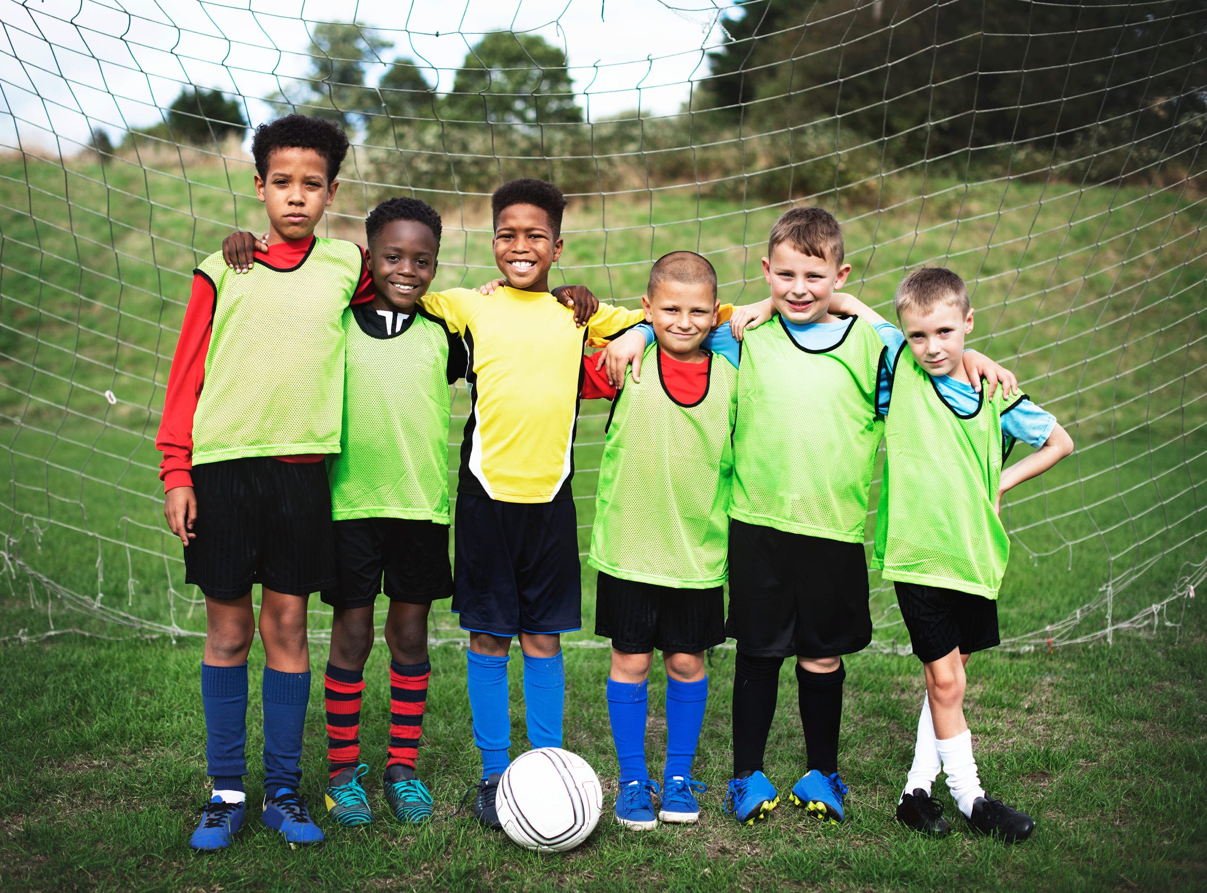
children grow their personal skills
Character development: Participating in sports teaches kids valuable life skills like discipline, responsibility, teamwork, and perseverance, which can be applied to many parts of their lives.
Goal setting: Pursuing athletic goals teaches kids how to set objectives, create plans, and work diligently to achieve their ambitions.
Positive Habits: Engaging in team sports helps kids develop social skills such as communication, cooperation, and conflict resolution, which are essential for personal relationships.

Slide 13
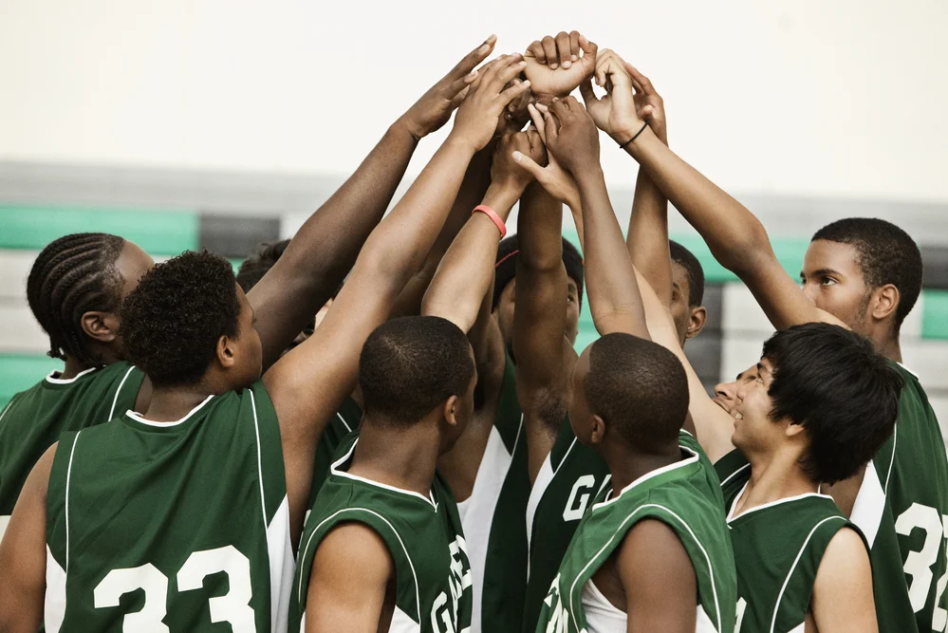
Significant long-term Benefits for Future Generation
Increase participation: Creating a more engaging, fun, and positive sports environment is Sport Dojo’s First priority to attract more young athletes to participate and stay active in sports to contribute to a more active generation.
Inclusivity : Focusing that all children regardless of their income, background, or resources will have access to quality coaching and participation will become more embraced in which it can help bridge socioeconomic gaps and promote diversity in sports
Empowered Coaches: Equipping coaches with technology and tools empowers them to provide more effective coaching. As coaches feel more capable and supported, they are more likely to stay engaged in coaching roles and positivity impact their athletes.

Slide 14
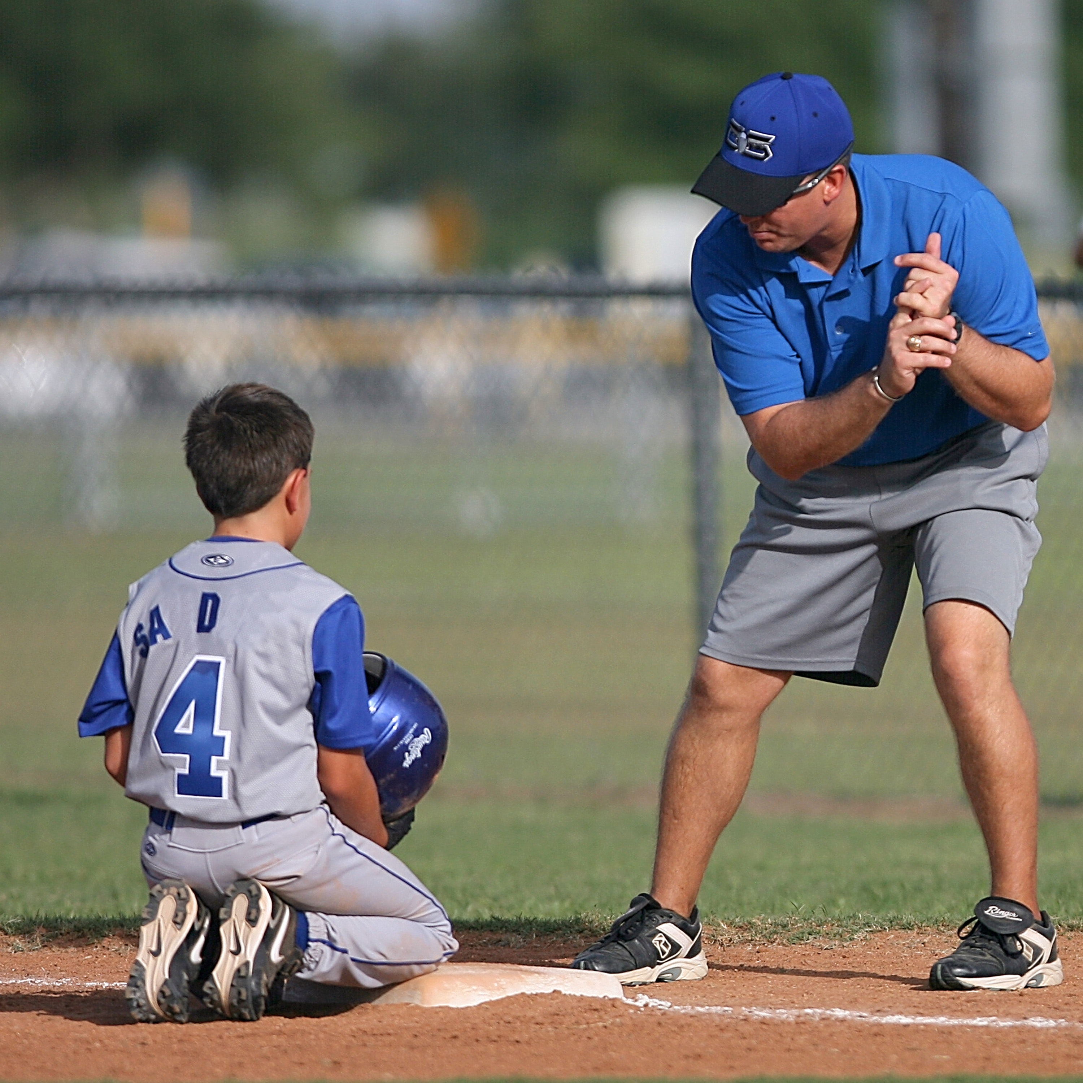
Coaches and staff benefits from these initiatives
Access to Advance technology: Coaches have access to data driven technology that can provide them faster and easier insights into player performance, tactics, and strategies in which it helps make more informed decisions
Improved Coaching Effectiveness: With the aid of technology and resources, coaches can refine their coaching methods and develop more effective training plans. This can lead to better player development and team performance.
Professional Networking: Engaging with the Sport Dojo’s platform can offer coaches the opportunity connect with other coaches, share ideas, and learn form their peers, fostering a sense of community and collaboration.

Slide 15
How can you help ?

Slide 16

Parent Involvement
Share informative articles, videos, or online courses related to coaching, sports psychology, and child development with coaches, parents and coaches to help awareness and educate other peers about the situation.
Promote Inclusivity: Encourage and support efforts to make sports more inclusive by advocating for diverse participation and helping to break down barriers to entry.
Collaborate with organizations: Partner with local sports organization, community centers, and schools to collectively improve coaching and sports experiences

Slide 17

Coach and Staff involvement
Embrace Positive Coaching methods: use positive reinforcement, encouragement, and constructive feedback to create a supportive and nurturing environment for young athletes.
Promote Inclusivity: Ensure that all athletes, regardless of their income, background, race, or skill level, always feel welcomed to the team.
Collaborate with parents: Build strong relationships with parents to ensure a unified support system for young athletes.

Slide 18
Be the Hero for our young coaches and athletes
Join us in shaping a brighter future for our youth through Sport Dojo’s transformative initiatives. By contributing your support, expertise, and passion, you’re empowering the next generation with the tools they need to thrive in sports and beyond. Let's come together to create a lasting impact on the lives of young athletes and pave the way for a stronger, more inclusive sporting community !

Slide 19
THANK YOU !

